Slide 1

Najlepsze praktyki dla Infrastructure-as-a-Code na przykładzie Terraforma
Wojciech Barczyński VP of Engineering

Slide 2
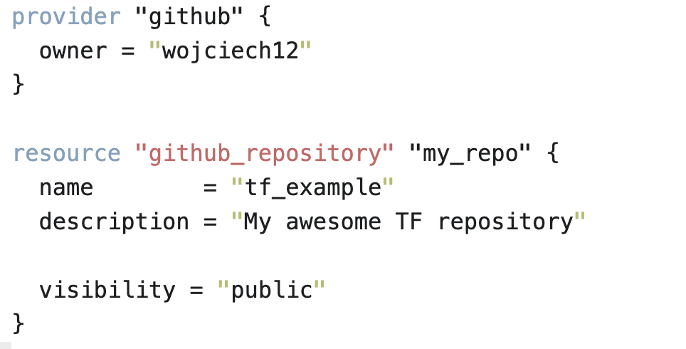
Co to jest Terraform

Slide 3
Co to jest Terraform
terraform plan – co się zmieni
terraform apply – wykonanie planu

Slide 4
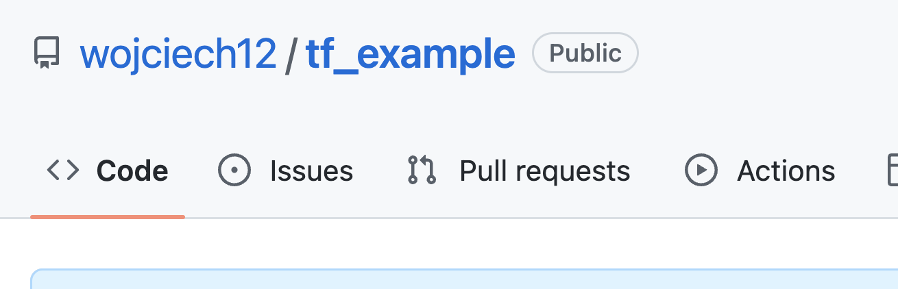
Co to jest Terraform
terraform state

Slide 5
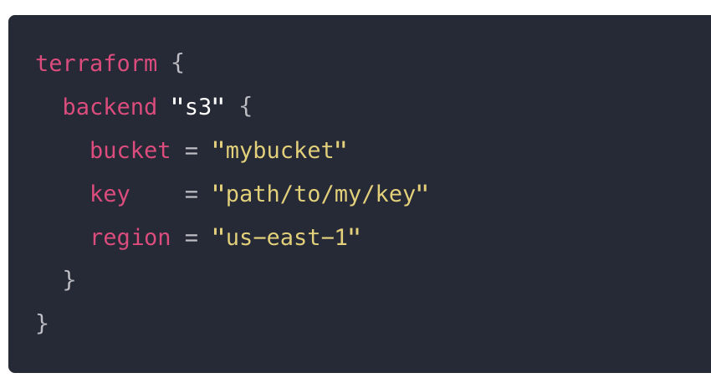
1. Remote state
AWS s3 + DynamoDB
Google Cloud Storage
Azure storage
Wystarczy po prostu copy&paste z dokumentacji.

Slide 6
2.

Slide 7
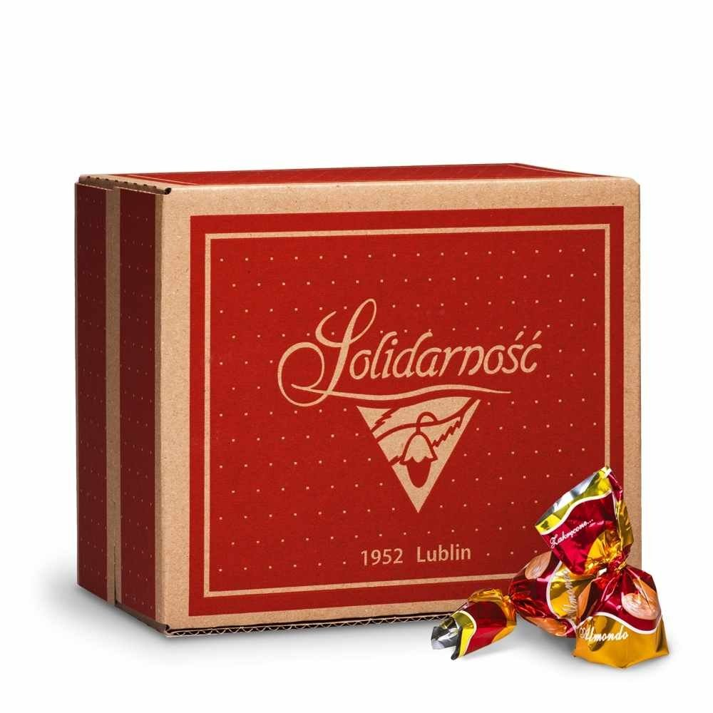
How to choose the tech?

Slide 8
High performance
Lead Time
Deployment frequency
Mean time to Recovery
Change Fail Percent

Slide 9
High performance
Commercial success
…
Satisfaction of the employees

Slide 10
Kubernetes
Common language
Artifacts
Platform

Slide 11
Hiring
Golang* developers passionate about system engineering, DevOps culture, or building tools.
* at least 1 year of experience in Golang.
Learn more/apply: https://grnh.se/9b76ed375us

Slide 12

Questions?
https://www.flickr.com/photos/bruno_brujah/

Slide 13
Backup

Slide 14
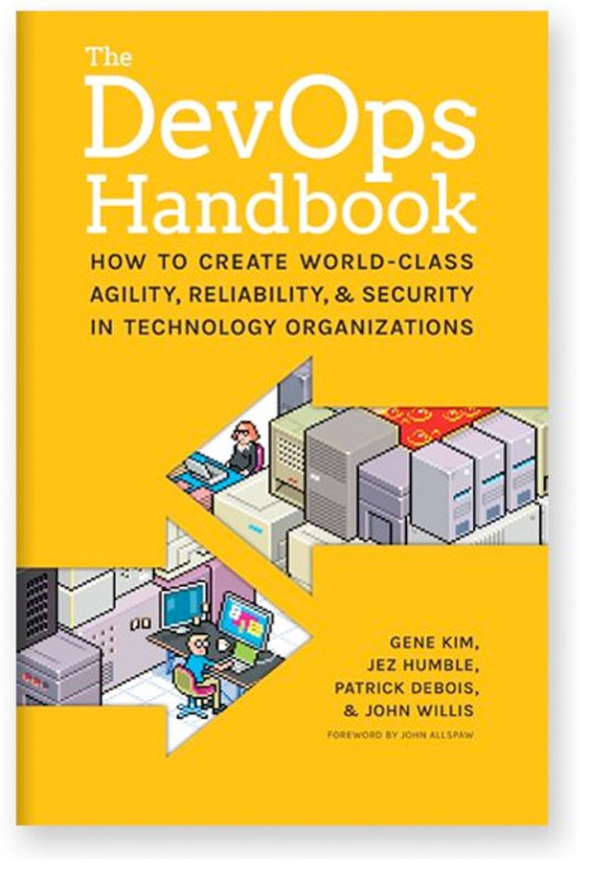
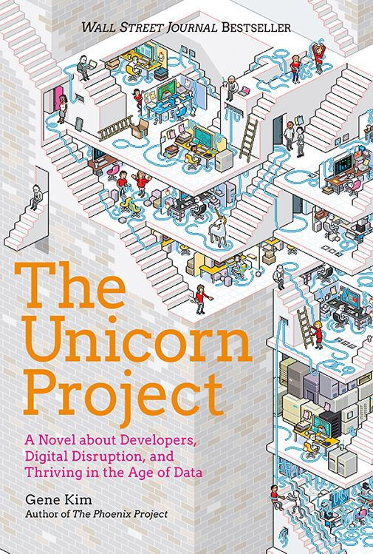
Recommended read
2
The first 4 chapters, the rest if you have time.
3
A story, not as straight forward as (1)
1
Concrete, do A, do B,
because C (DevOps here as culture, not an admin ☺ )

Slide 15

The way of Kubernetes
In iterations
Learn-as-you-go
https://www.flickr.com/photos/bruno_brujah/

Slide 16
Rabbit holes everywhere…
Approach:
The iteration, decision, deliver
As soon as possible to get into the cycle Patch Patch Patch
Alternative take:
Lean v1/v2*
* https://katemats.com/blog/lean-software-development-build-v1s-and-v2s

Slide 17
OODA
https://upload.wikimedia.org/wikipedia/commons/3/3a/OODA.Boyd.svg

